Slide 1
Code-A-Thon 2024
Team 24

Slide 2




Intro
A terrific team with diverse backgrounds across SE, UI/UX, Analytics, Tech Support
Prompt 1: Optimizing the anticipation of customer orders coming into pharmacies across the country
Vardan
Robert
Ashish
Fina
Dmitry

Slide 3

Business Use Case
Notes:
Visualize demand for medication and ensure pharmacies can handle the volume
Improve insights into what medications patients may need
Use predictive analytics to better manage inventory/demand
Provide vital information to patients so that they can better take care of themselves
Proactive monitoring of conditions to drive better health outcomes and volume to our pharmacy
MVP focused on seasonal allergies

Slide 4

Business Use Case
Notes:
Visualize demand for medication and ensure pharmacies can handle the volume
Improve insights into what medications patients may need
Use predictive analytics to better manage inventory/demand
Provide vital information to patients so that they can better take care of themselves
Proactive monitoring of conditions to drive better health outcomes and volume to our pharmacy
MVP focused on seasonal allergies

Slide 5
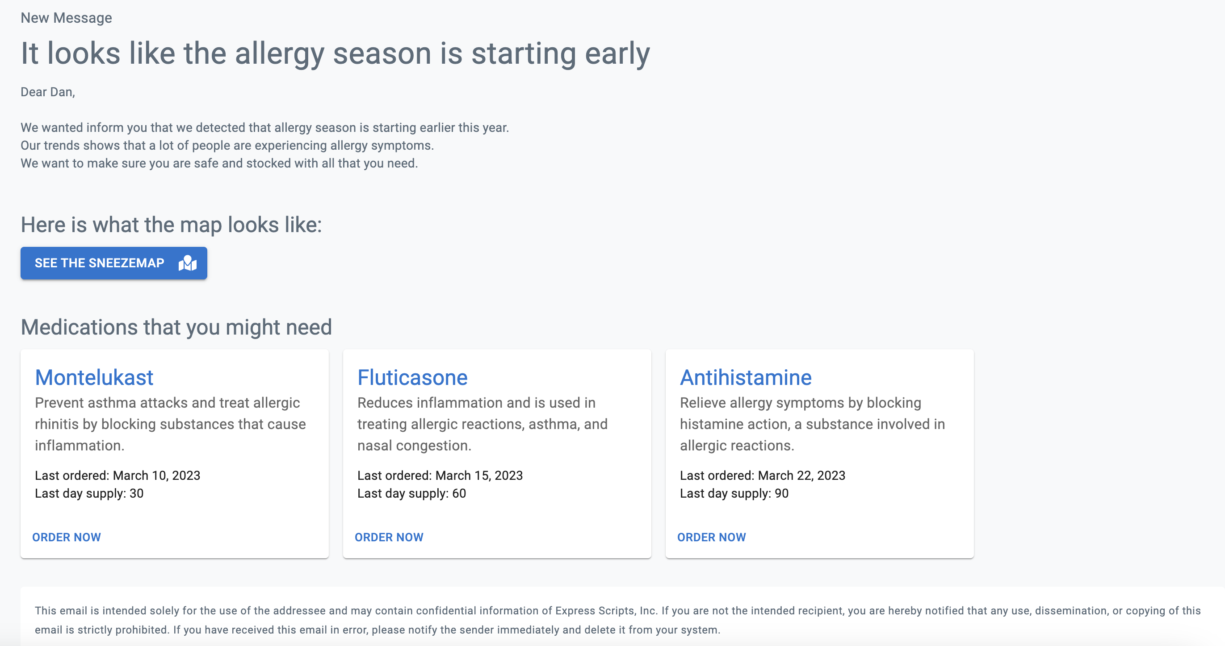
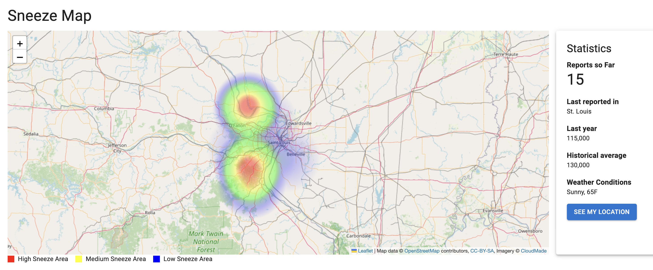
Business Use Case
Notes:
Visualize demand for medication and ensure pharmacies can handle the volume
Improve insights into what medications patients may need
Use predictive analytics to better manage inventory/demand
Provide vital information to patients so that they can better take care of themselves
Proactive monitoring of conditions to drive better health outcomes and volume to our pharmacy
MVP focused on seasonal allergies

Slide 6
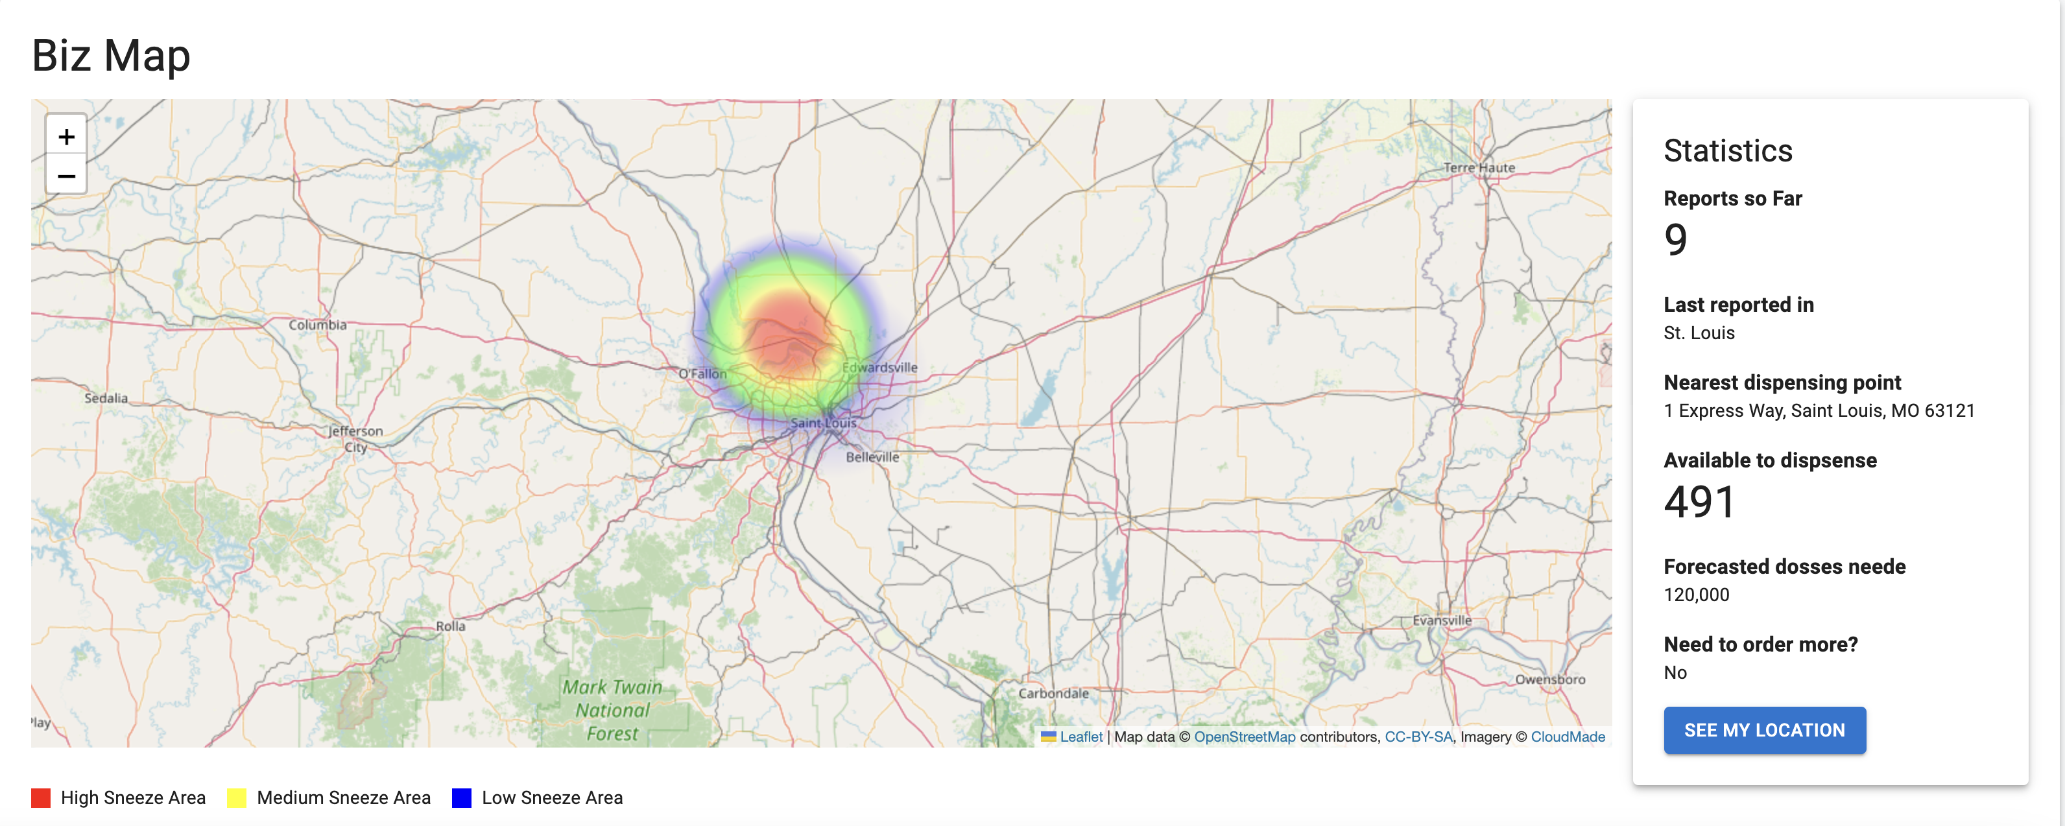
Business Use Case
Notes:
Visualize demand for medication and ensure pharmacies can handle the volume
Improve insights into what medications patients may need
Use predictive analytics to better manage inventory/demand
Provide vital information to patients so that they can better take care of themselves
Proactive monitoring of conditions to drive better health outcomes and volume to our pharmacy
MVP focused on seasonal allergies

Slide 7
Solution
External Sources
(social media)
Internal Sources
(Claims/Patient History)
Predictive Analytics
Improved Pharmacy Management and Patient Outcomes

Slide 8
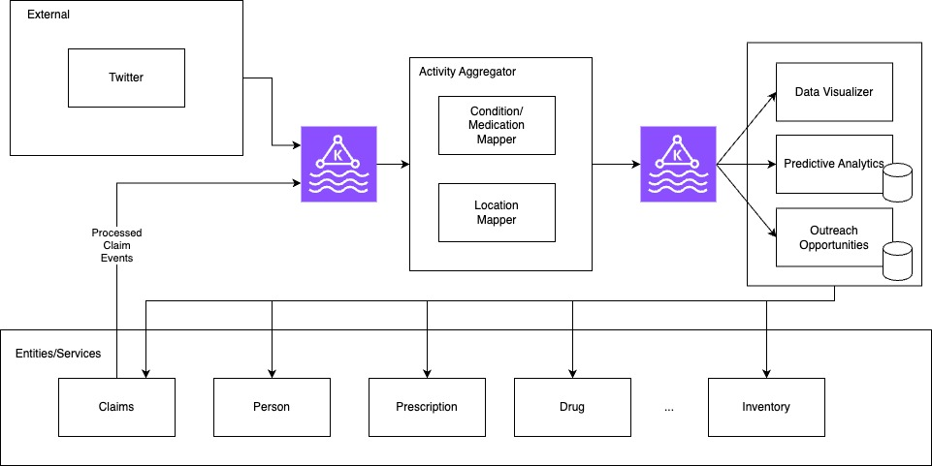
Architecture

Slide 9
Prediction Model
Collect Data
Demographic
Prescriptions
Disease
Develop Model
Linear Regression
Predict Demand
Adjusted Prediction
Multiplication factors
Assumptions
Focus is on allergy medicines.
Asthma allergy and Montelukast demand is considered for developing the model.
Factors included for the linear regression
Age, Race, Gender
Urban/rural population ratio (Most intuitive)
Multiplication factors
% of population in a State.
% of express script market share.
% of population with Asthma.
Average allergy score for the state.
Social Media feed.
Regression Statistics
Significance level 90% (alpha = 0.1)
Adjusted R square 0.4586
Significance F 0.009295

Slide 10




Tech Stack

Slide 11
Demo

Slide 12
Q&A?

Slide 13
References
Urban Percentage of the Population for States, Historical | Iowa Community Indicators Program (iastate.edu)
US States - Ranked by Population 2024 (worldpopulationreview.com)
United States of America - Demographics - Place Explorer - Data Commons
(https://datacommons.org/)
AAFA 2023 Allergy Capitals Report March 2023

